Slide 1
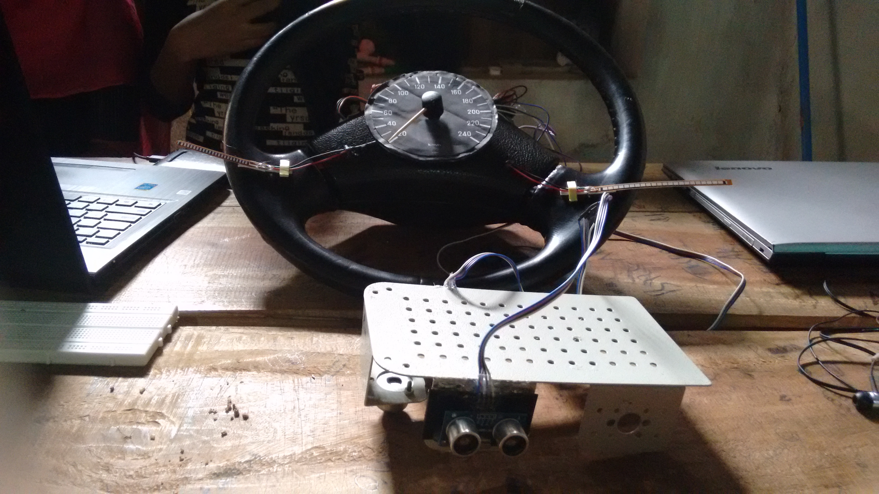
SMART STEERING WHEEL
BY
ARATHY FRANCIS
ARYA MOHAN
FATHIMATH FARZEENA SHIRIN
LEKSHMIPRIYA BL

Slide 2
INTRODUCTION
In recent years, driver drowsiness has been one of the major causes of road accidents and can lead to severe physical injuries, deaths and significant economic losses. Statistics indicate the need of a reliable driver drowsiness detection system which could alert the driver before a mishap happens. A method and steering wheel for determining and verifying a state of driver alertness includes receiving a response at a steering wheel. If the subject is in the state of drowsiness then an alert is generated from their mobile phone and a message is send to the selected contact list. Also they can view their drowsiness pattern.

Slide 3
GOALS AND OBJECTIVES
GOALS
This systems checks whether a person falls asleep during the journey thereby ensuring safety
OBJECTIVES
It measures drowsiness of the driver for preventing accidents.
Registers speed at which the vehicle is moving and location at which driver fell sleep.
Sends notification to emergency contacts there by alerting them before accident occur.

Slide 4
MODULES
SENSORING MODULE
1.FLEX SENSORS
2.ULTRA SONIC SENSORS
SPEED MODULE
POTENTIOMETER
BLUETOOTH MODULE
ANDROID APP
WEB PAGE

Slide 5
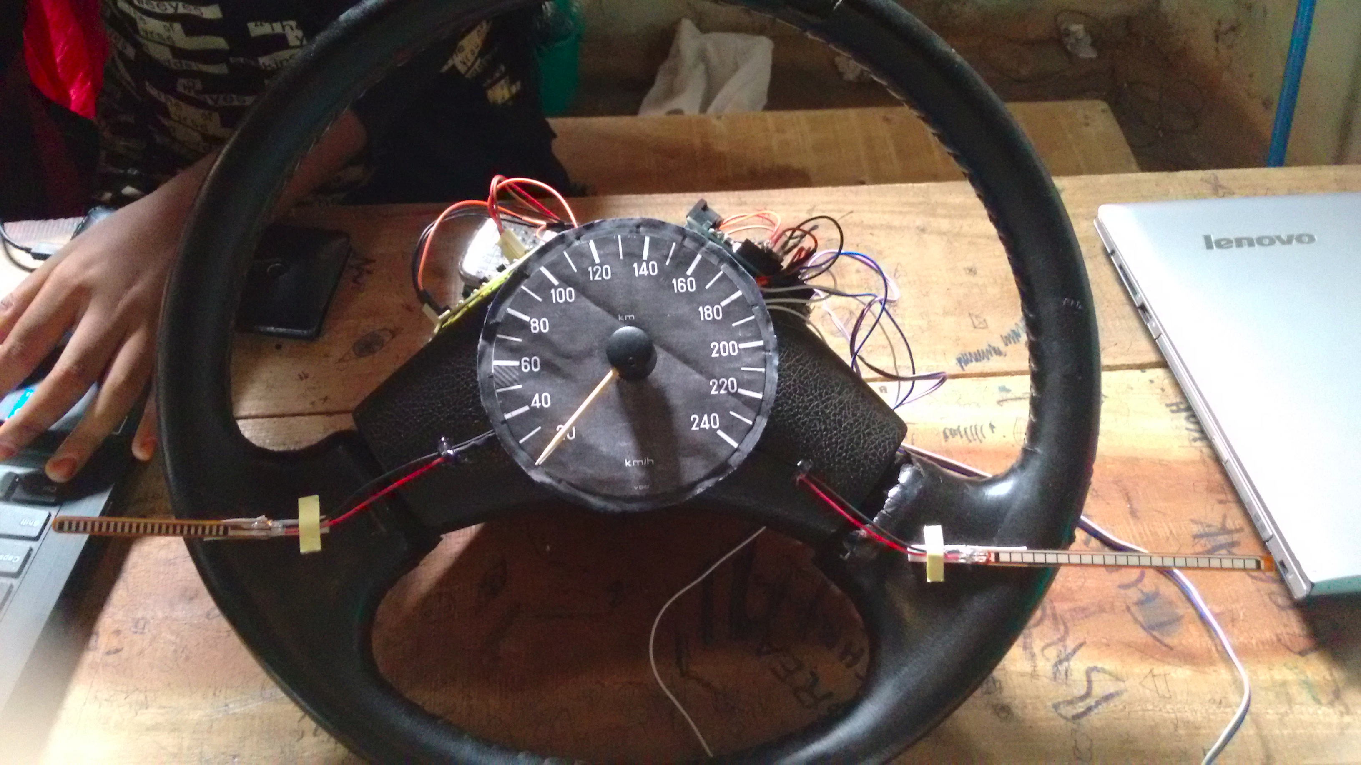
SENSOR MODULE
FLEX SENSOR
Flex sensor is a component that
changes the resistance when bent.
It measures the pressure applied
on the steering wheel.

Slide 6
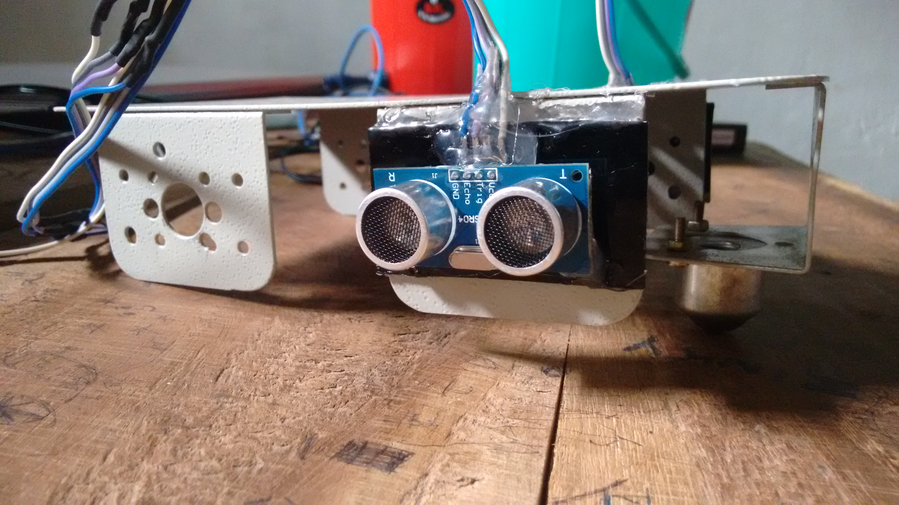
ULTRA SONIC SENSOR
Ultrasonic Sensors are self-contained
solid-state devices designed for non
contact sensing of solid objects.
This measures the distance from
nearby obstacles.

Slide 7
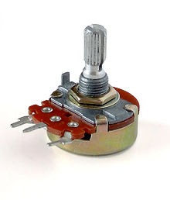
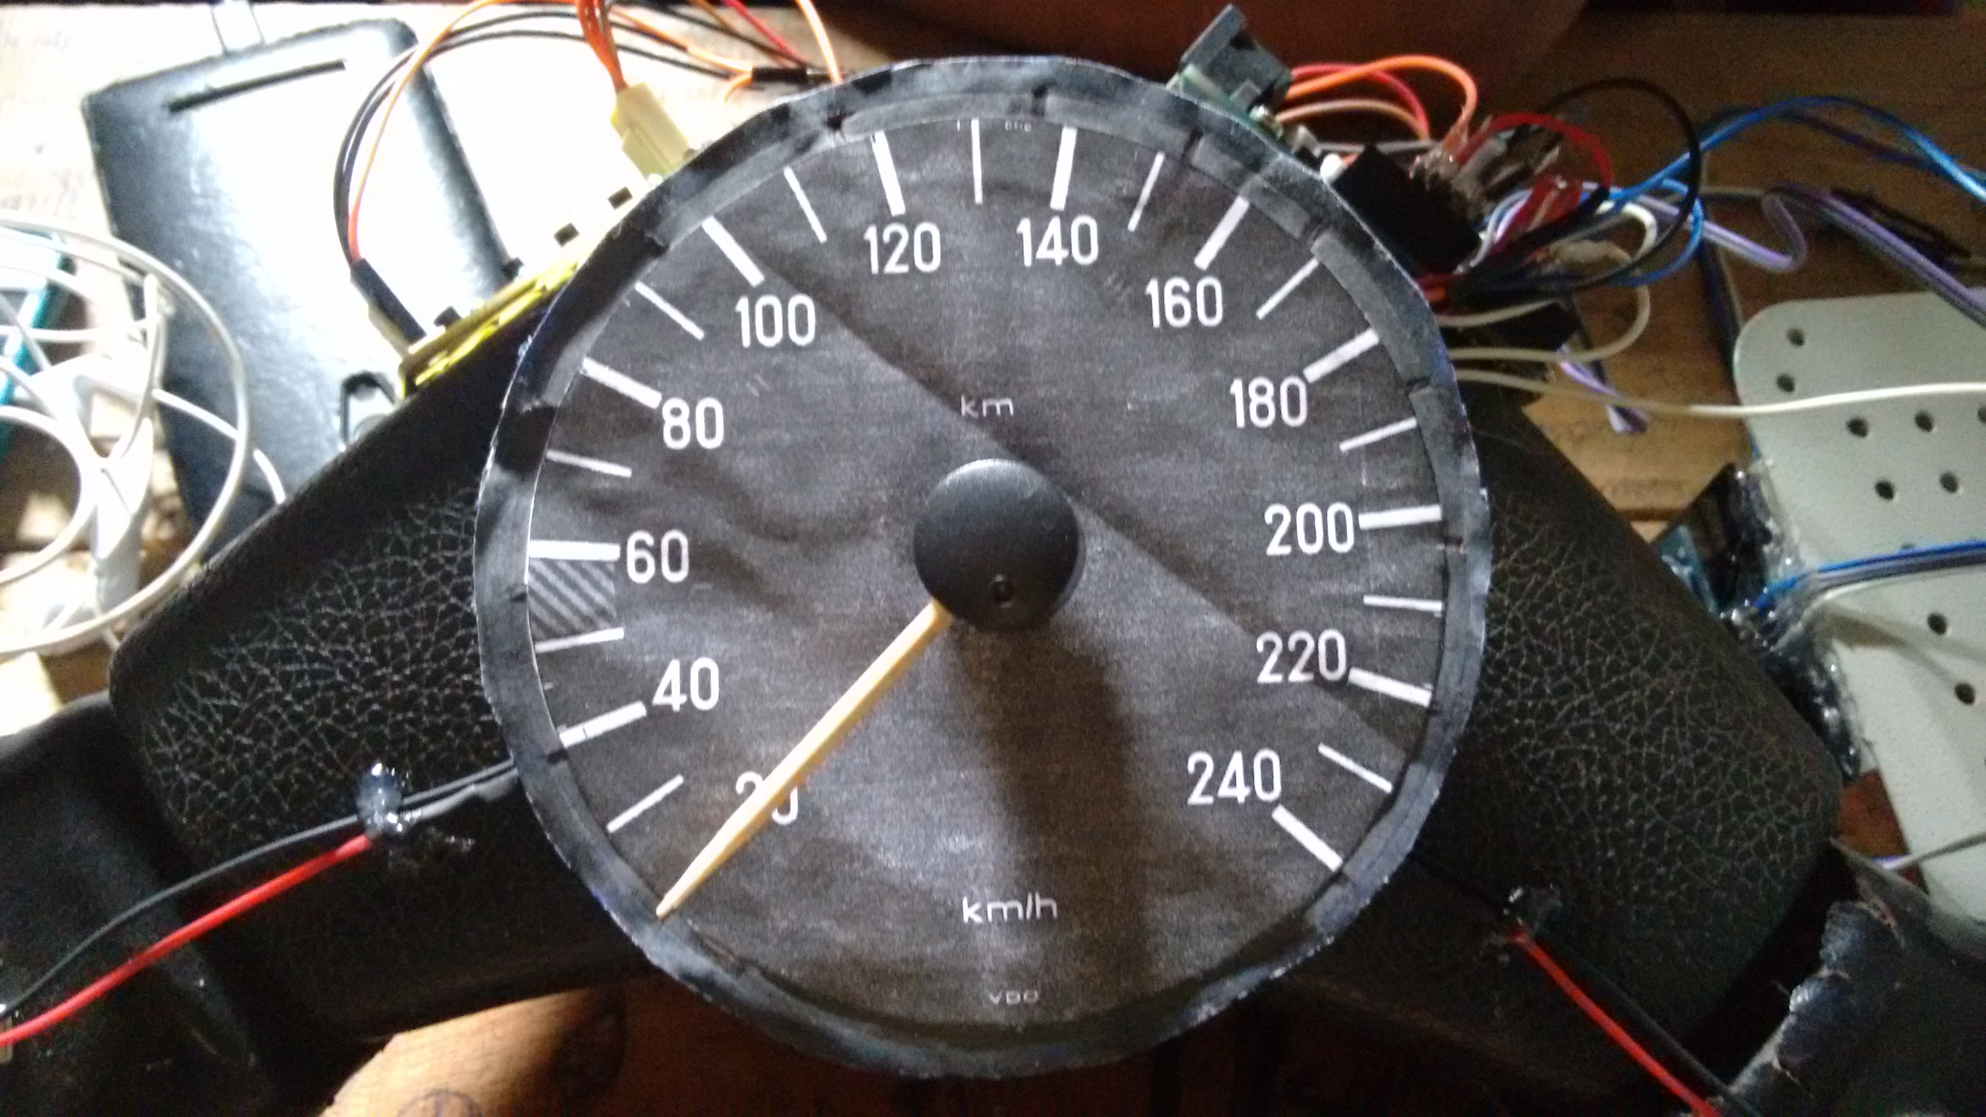
SPEED MODULE
A potentiometer, informally a pot,
is a three-terminal resistor with a
sliding or rotating contact that forms
an adjustable voltage divider.
Here we used this to measure the
speed variation.

Slide 8
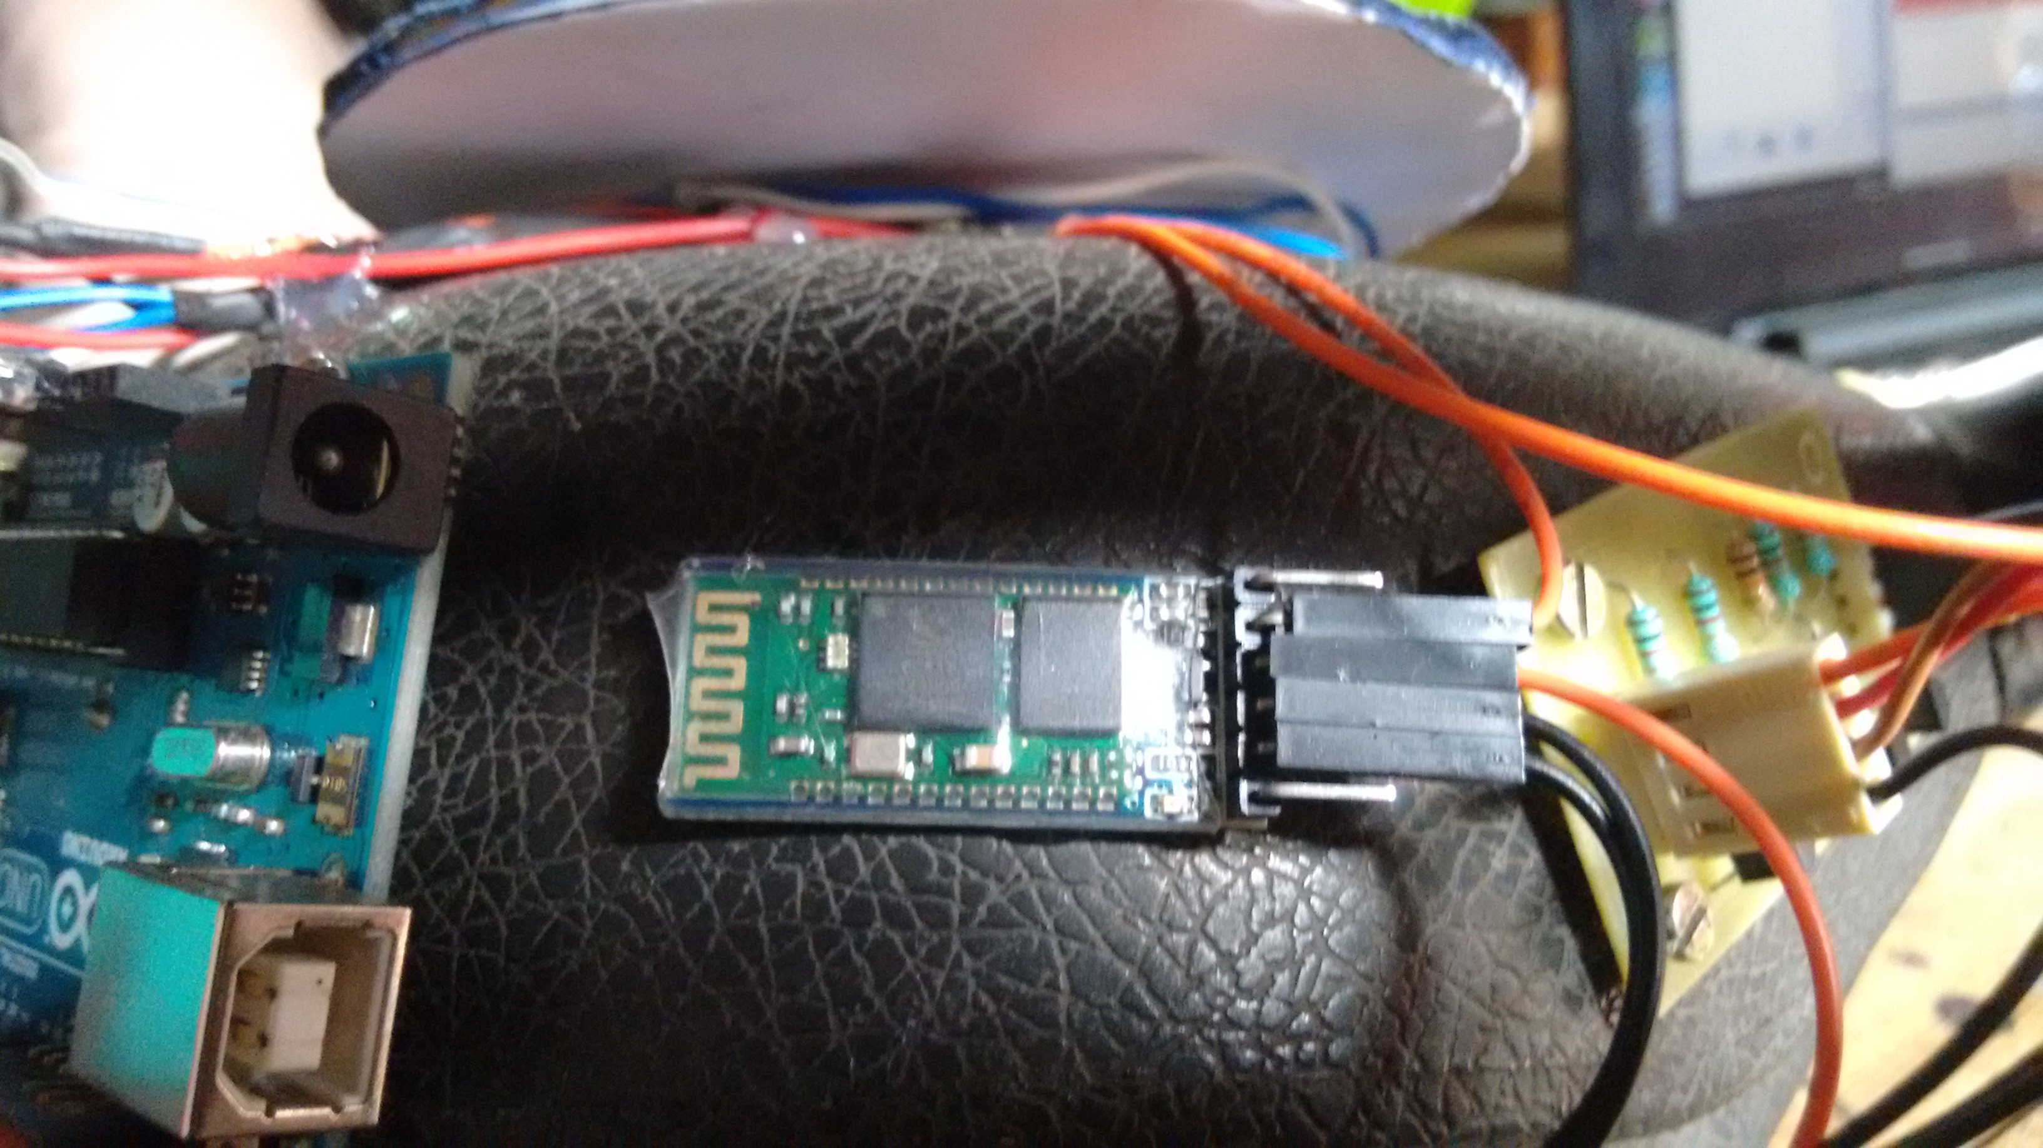
BLUETOOTH MODULE
HC-05 module is an easy to use
Bluetooth SPP (Serial Port Protocol)
module, designed for transparent
wireless serial connection setup.

Slide 9
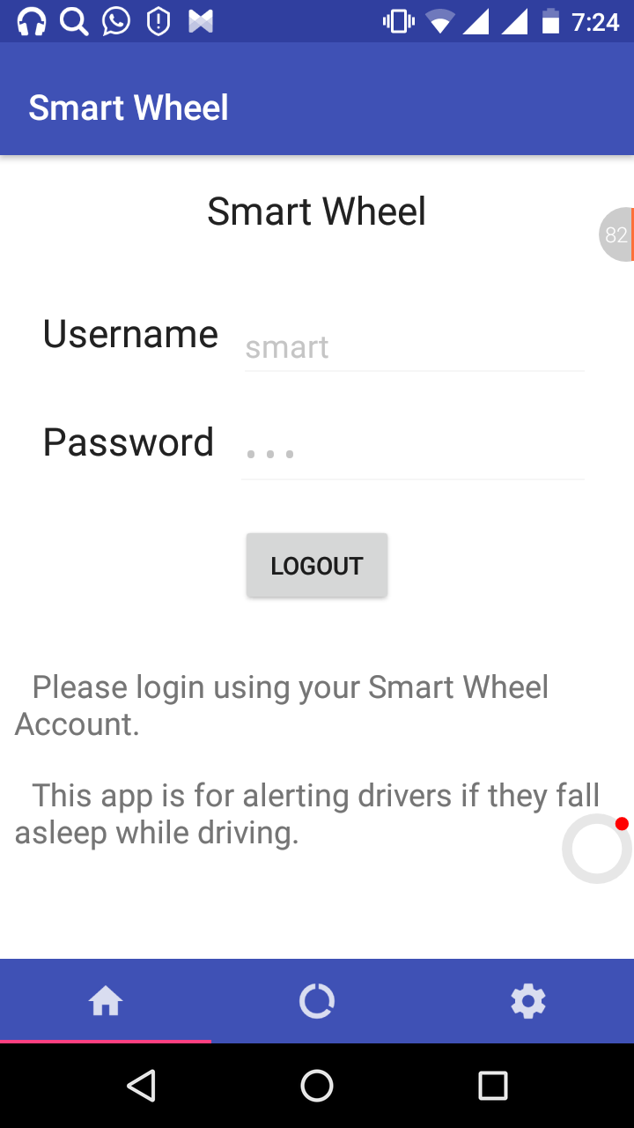
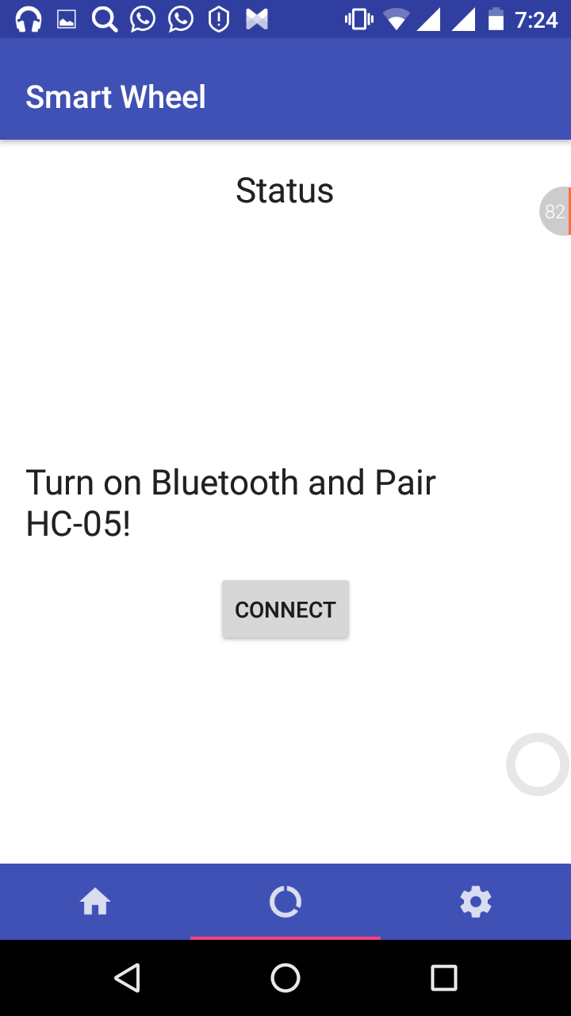
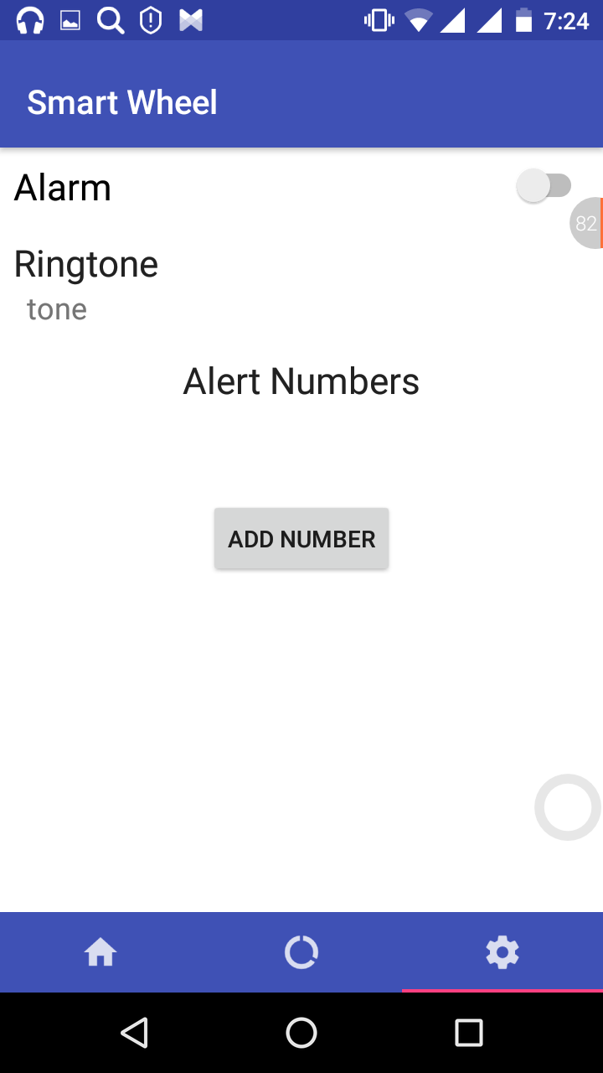
ANDROID APP

Slide 10
Our app shows the current status of the driver as per the data colleted from sensing unit and speed module.
First we have a login page which directed to the status page where we have to connect mobile bluetooth with bluetooth module.
We have a settings icon in which we can set alarm and can add emergency contacts.

Slide 11
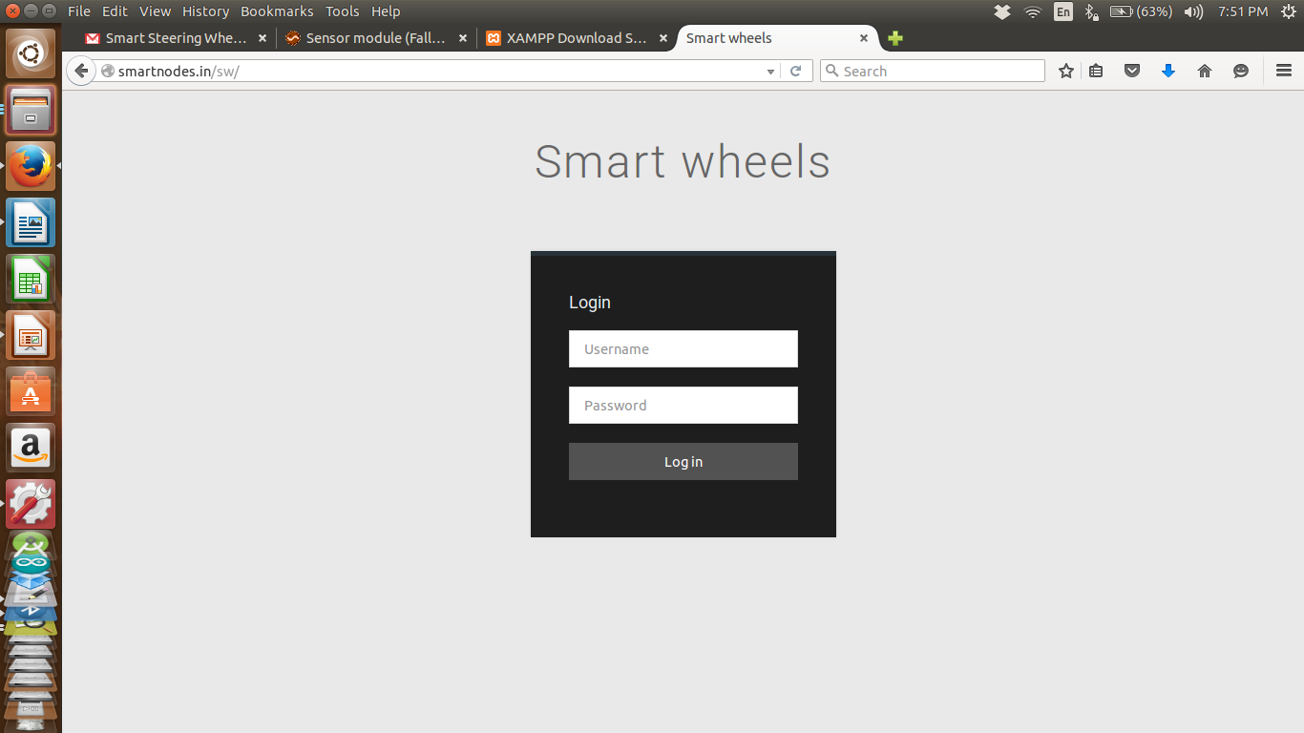
WEB PAGE
Shows the login page ,where the user can login with the registered user name and password.

Slide 12
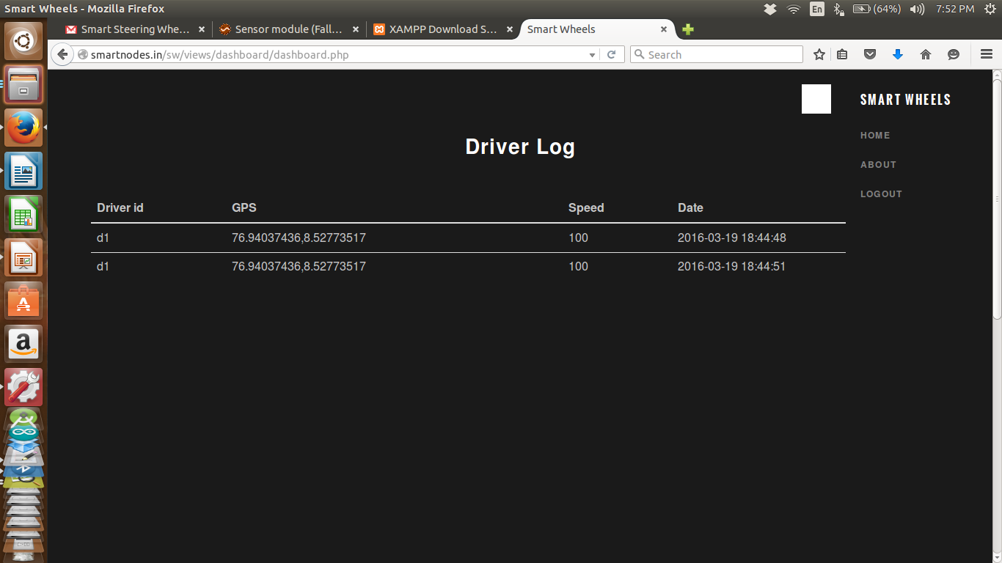
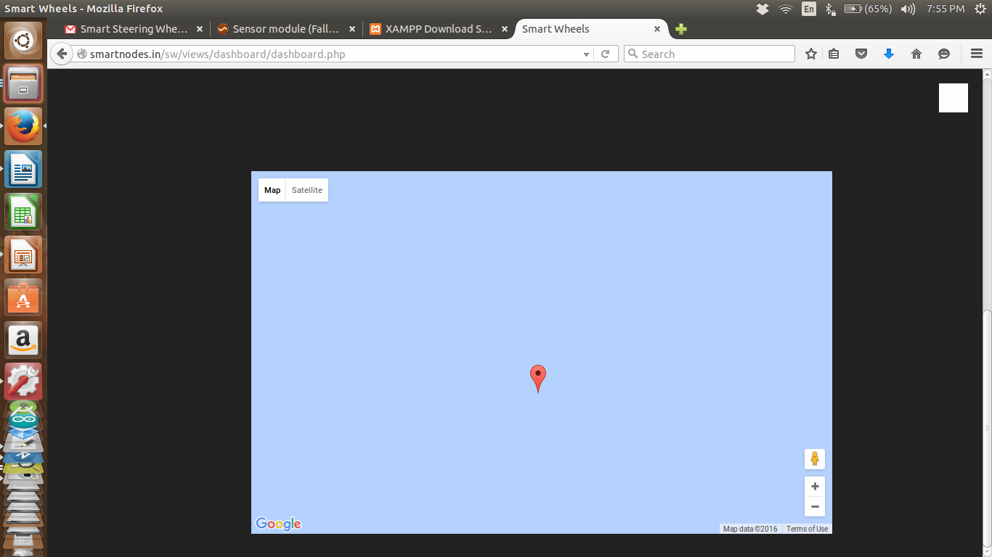
The login page directs to driver's login.Here we can see driver id,GPS,speed and date of the drive and on clicking the GPS coordinates the google map will be shown.

Slide 13
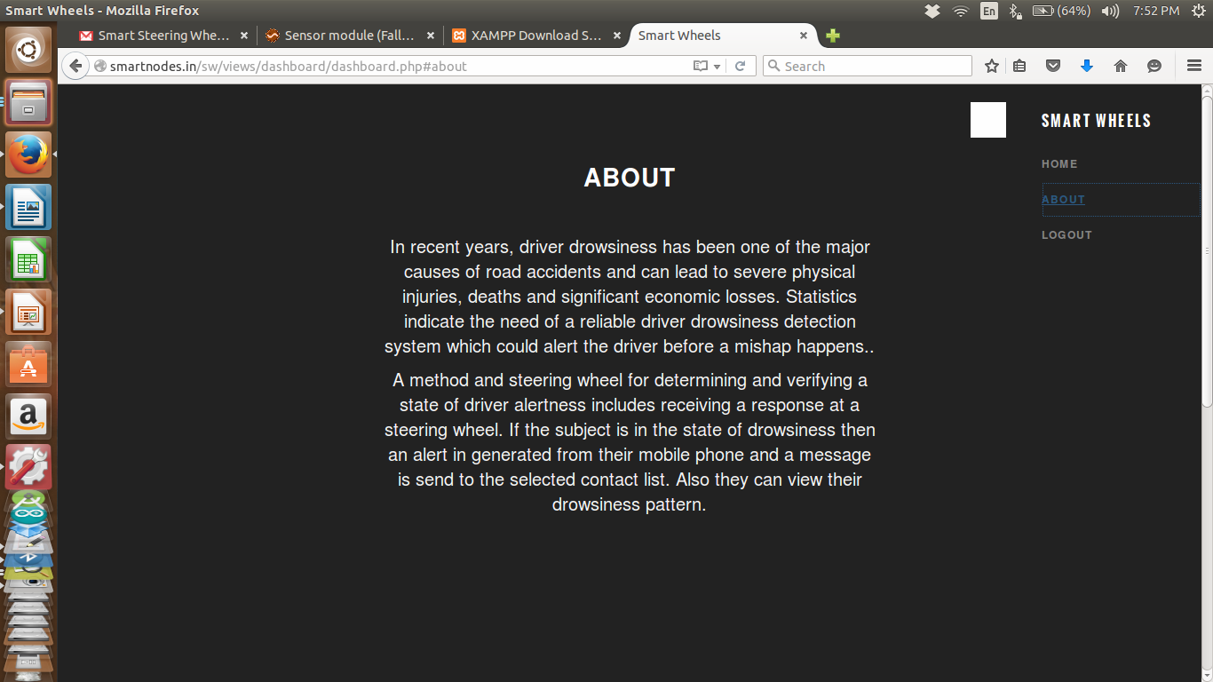
This page shows descriptions about the website.

Slide 14
THANK YOU...

